Slide 1

Department of Electronics and Communication Engineering
Automated Design Error Debugging of Digital VLSI Circuits By Using Convolutional Autoencoder
Name of the Guide
Mr . S . Chandrasekhar
Students Name and Roll Numbers:
M.Sanjay - 218T1A0421
D . Vamsi - 218T1A0408
A . Vamsi Krishna - 218T1A0402
G .Ajay Kumar - 218T1A0414

Slide 2
Contents
Abstract
Introduction
Literature Survey
Problem Statement
Objective
Proposed Technique
Results
Future Scope
Conclusion
References

Slide 3
Abstract
In this project, we propose an automated debugging approach for detecting and localizing faults in digital VLSI circuits using Convolutional Neural Networks (CNNs). The methodology involves leveraging autoencoders to extract meaningful features from test patterns, reducing dimensionality while maintaining high accuracy. Stacked Sparse Autoencoders (SSAE) are employed to classify fault patterns effectively. The integration of GPU-accelerated computation enhances the efficiency of fault detection, making the approach scalable for large circuits. By optimizing test pattern generation, the proposed system aims to improve debugging speed, accuracy, and reliability. This work presents a robust machine learning-based alternative to traditional fault detection techniques in VLSI design.

Slide 4
Introduction:
This project focuses on finding and fixing design errors in digital VLSI circuits. As modern chips become more complex, manual checking methods are no longer effective. We used machine learning techniques like Convolutional Autoencoder (CAE) and Convolutional Neural Network (CNN) to detect faults. The Atalanta tool helps generate test patterns, which are then analyzed for errors. Our model gives better accuracy compared to older methods. It saves time, reduces human effort, and works well for complex circuits. This method helps improve chip quality and makes fault detection faster and more reliable.

Slide 5
Literature survey Overview
Year | Author(s) | Title | Methodology | Detection Technique | Drawbacks | Accuracy | Findings
2014 | JoS, Matsumoto T, Fujita M | SAT-based automatic rectification and debugging of combinational circuits with LUT insertions | SAT-based rectification and debugging | LUT insertion for error correction | Computational complexity due to SAT solving | High | Effective debugging with LUT-based corrections
2019 | Gaber L, Hussein AI, Moness M | Improved automatic correction for digital VLSI circuits | Automatic error correction approach | Pattern-based error detection | Limited scalability for larger circuits | Improved compared to previous methods | Enhanced VLSI circuit correction efficiency
2020 | Gaber L, Hussein AI, Moness M | Incremental Automatic Correction for Digital VLSI Circuits | Incremental correction approach | SAT-based incremental error detection | Potential increase in correction latency | High | Faster and more efficient correction methodology
​

Slide 6
Problem Statement:
Detecting design faults in modern digital VLSI circuits is difficult due to their increasing complexity. Traditional methods like manual inspection or simple neural networks are slow, less accurate, and not suitable for large and complex chips. These methods often miss small faults like stuck-at faults, which can lead to major issues in electronic devices.

Slide 7
Objectives
This project focuses on automating the debugging of errors in digital VLSI circuits using CNN-based techniques.
The approach leverages autoencoders for feature extraction, reducing the dimensionality of test patterns while maintaining high accuracy.
Machine learning classifiers, particularly stacked sparse autoencoders (SSAE), are used to enhance fault pattern detection and localization.
The proposed method improves fault detection efficiency by integrating GPU-accelerated computation and optimizing test pattern generation for large-scale circuits.

Slide 8
Proposed Methodology
Explanation of the Atalanta Tool:
Atalanta is a widely used Automatic Test Pattern Generation (ATPG) tool designed for generating test patterns to detect faults in combinational circuits. It is particularly useful in VLSI testing and digital circuit fault analysis.
Key Features of Atalanta:
Fault Detection:
Identifies stuck-at faults in combinational circuits.
Generates efficient test patterns to diagnose faults.
Test Pattern Generation (TPG):
Produces optimized test vectors to minimize test time and complexity.
Helps in validating circuit functionality by detecting errors.
Applications of Atalanta:
Used in VLSI testing and fault diagnosis in digital circuits.
Supports benchmark circuit testing, ensuring correctness before fabrication.

Slide 9
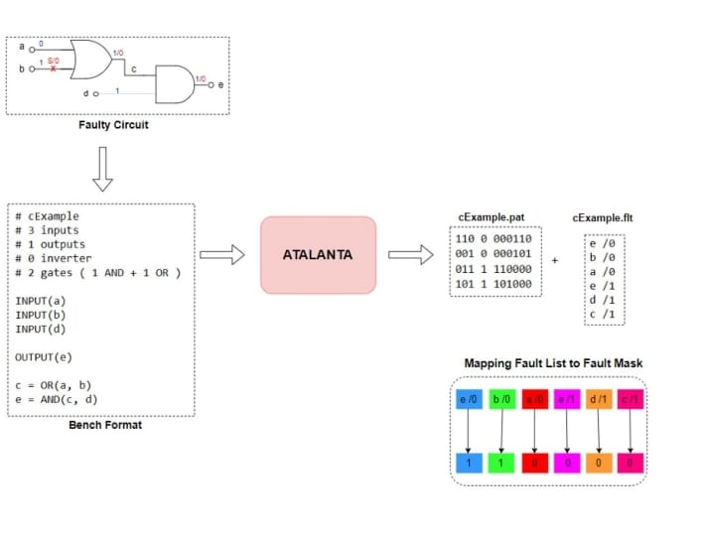
Sample example Explanation

Slide 10
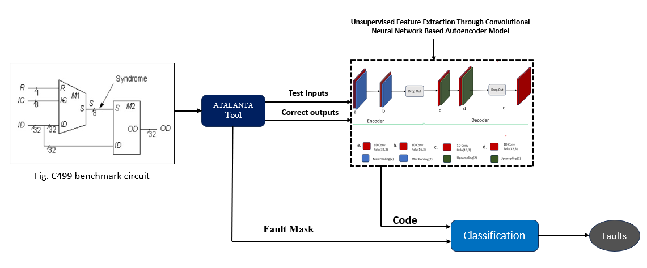
Block Diagram
Fig 04. Proposed Unsupervised CAE Model

Slide 11
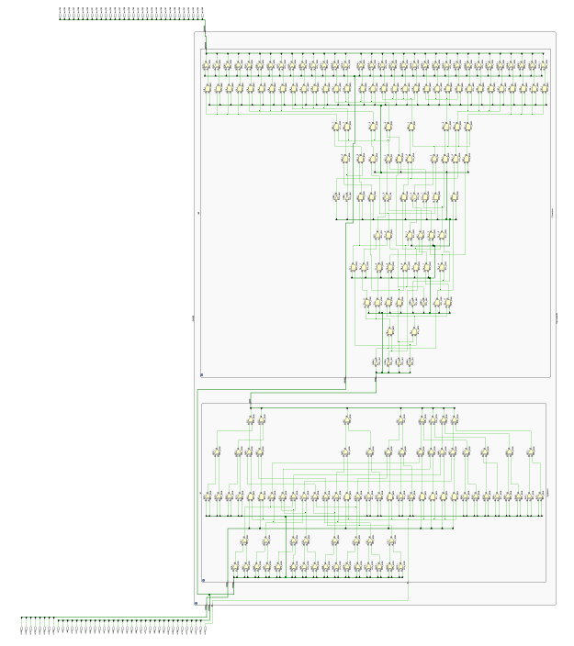
C499 Circuit Diagram

Slide 12
C499.bench file
# c499
# 41 inputs
# 32 outputs
# 40 inverters
# 162 gates ( 56 ANDs + 40 NANDs + 2 ORs + 104 XORs ) INPUT(1)
INPUT(5)
INPUT(9)
INPUT(13)
INPUT(17)
INPUT(21)
INPUT(25)
INPUT(29)
OUTPUT(724)
OUTPUT(725)
OUTPUT(726)
OUTPUT(727)
OUTPUT(728)
OUTPUT(729)
OUTPUT(730)

Slide 13
C499 .bench file(Explanation)
The C499 circuit is a combinational logic circuit used for error detection and correction, consisting of 41 inputs, 32 outputs, and 202 logic gates.
The circuit starts INPUT(1), INPUT(5), ..., INPUT(137), which serve as test patterns.
with 41 input signals labeled as XOR gates (104 total) perform the first stage of processing, comparing pairs of input signals to detect mismatches. If inputs are different, the XOR output is 1 (error detected), otherwise, it is 0 (no error).
AND gates (56 total) take XOR outputs and validate errors by ensuring multiple signals are faulty before marking a detected fault.
OR gates (2 total) aggregate fault signals from multiple AND gates to create a single fault detection output for better error handling.
NOT gates (40 total) are used in the final stage to invert signals and refine fault indicators.
The final 32 outputs, labeled as OUTPUT(724), OUTPUT(725), ..., OUTPUT(755), represent the circuit's fault detection results, indicating which input patterns caused errors.
The circuit structure is optimized for fault-tolerant computing, ensuring that error detection is efficient in digital circuits.

Slide 14
Implementation Steps for Test pattern Generation
Step 1: Install and Setup Atalanta
Ensure Atalanta tool is installed and ready to use.
Step 2: Prepare the .bench File
Make sure the c499.bench file is available.
Step 3: Run Atalanta Tool
Open Command Prompt/Terminal.
Navigate to the directory containing c499.bench and Atalanta tool.
Run this command:
Step 4: Generated Files
Atalanta will generate:
.test file – Contains test vectors (input-output pairs).
.vector file – Contains signal states for each cycle.
Summary report – Contains verification results and error analysis.

Slide 15
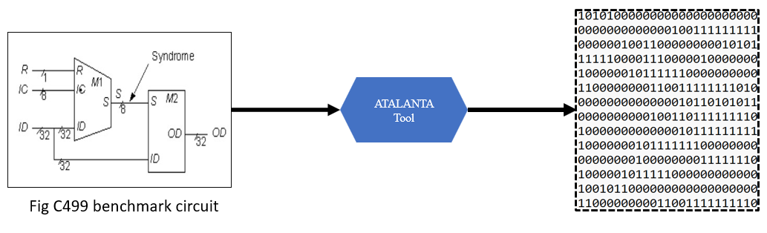
Step 5: Inspect Files
Open the .test and .vector files in a text editor.
Review the summary report for circuit verification results.
Step 6: Use the Files
Use the generated files for fault simulation or machine learning model training.

Slide 16
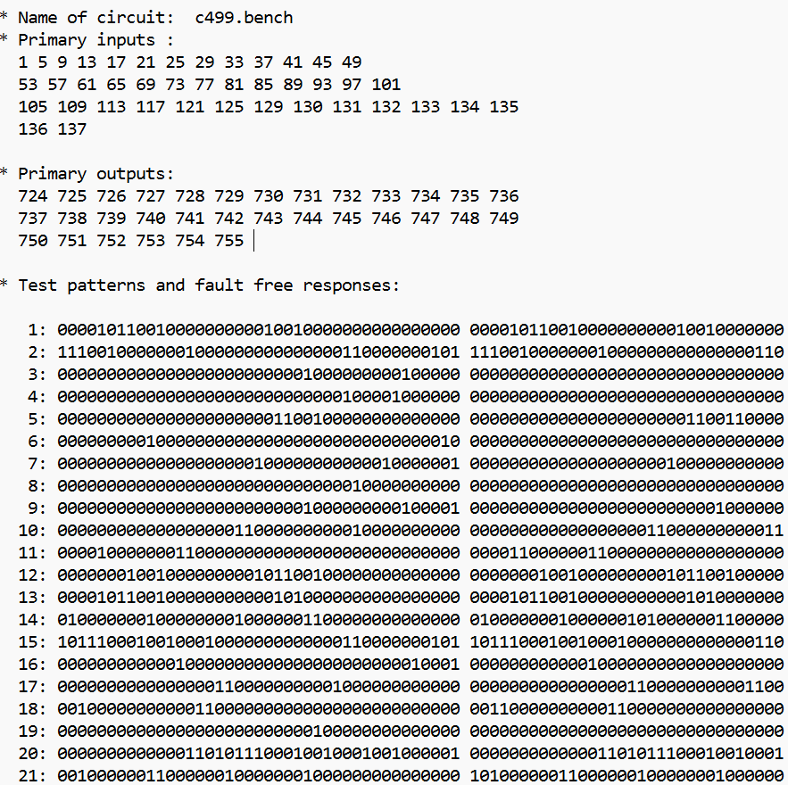
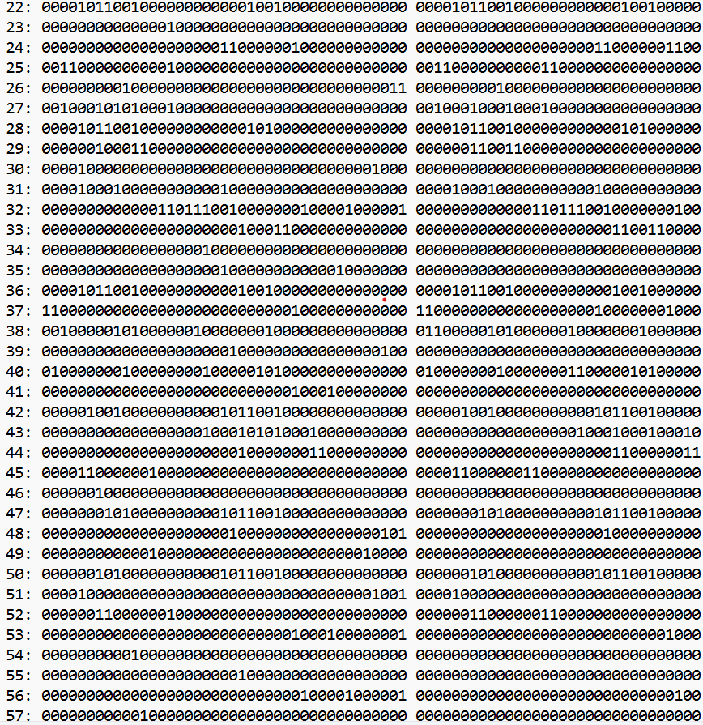
C499.test file

Slide 17
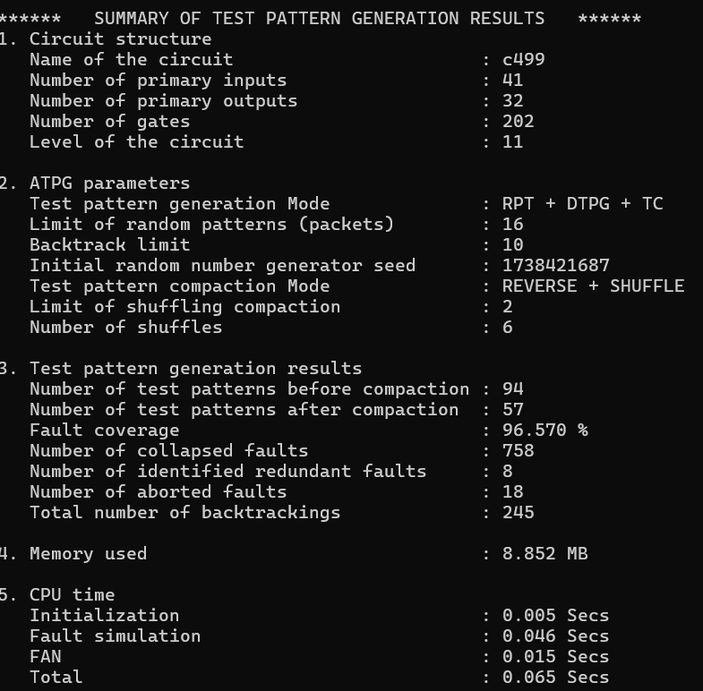
Summary report for C499 .bench file

Slide 18
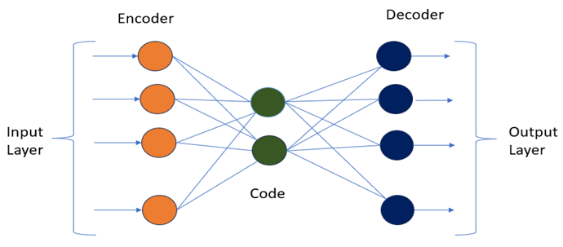
Autoencoder Model
Autoencoders are a specialized type of feedforward neural network used for representation learning. Their primary objective is to find a compressed latent-space representation of input data, which can later be used to reconstruct the original input. Autoencoders serve as effective tools for dimensionality reduction and feature extraction. They operate as unsupervised learning models since they do not require labelled data for training.
In this project, both Deep Autoencoder (DAE) and Convolutional Autoencoder (CAE) are used to process test patterns generated by the Atalanta tool for VLSI circuit fault detection. The reconstructed outputs are then passed to a classifier to identify faults in the circuit.
Fig .Simple Autoencoder

Slide 19
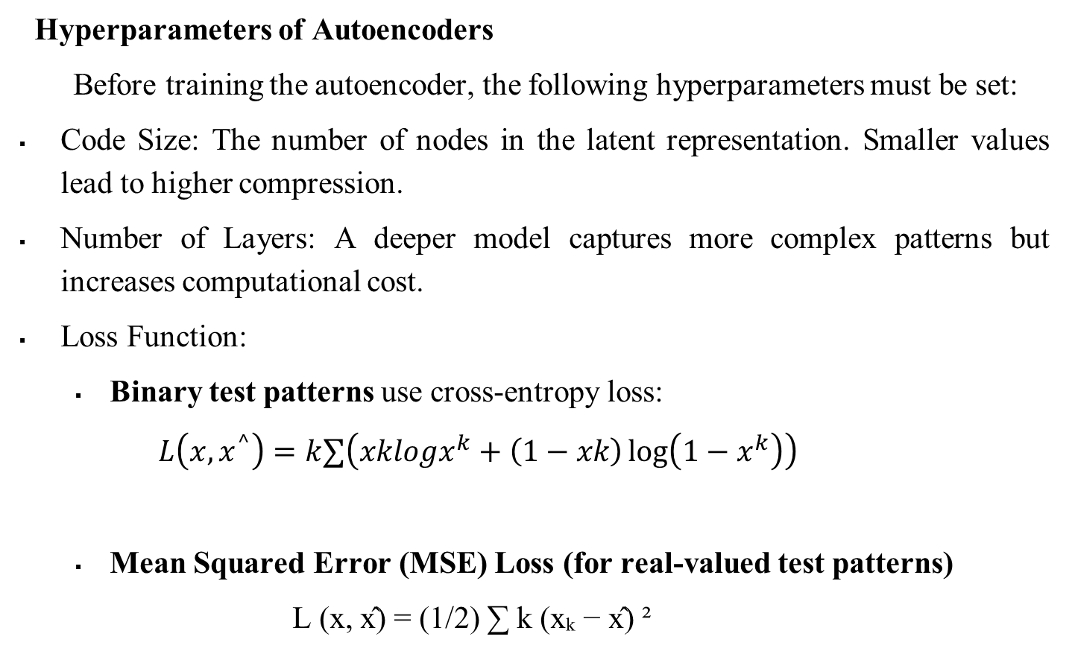
Hyperparameters of Autoencoders
Before training the autoencoder, the following hyperparameters must be set:
Code Size: The number of nodes in the latent representation. Smaller values lead to higher compression.
Number of Layers: A deeper model captures more complex patterns but increases computational cost.
Loss Function:
Binary test patterns use cross-entropy loss:
$$L\left(x,x^{^}\right)=k∑​\left(xk​logx^{k​}+\left(1−xk​\right)\log\left(1−x^{k​}\right)\right)$$
Mean Squared Error (MSE) Loss (for real-valued test patterns)
L (x, x̂) = (1/2) ∑ k (xₖ − x̂) ²

Slide 20
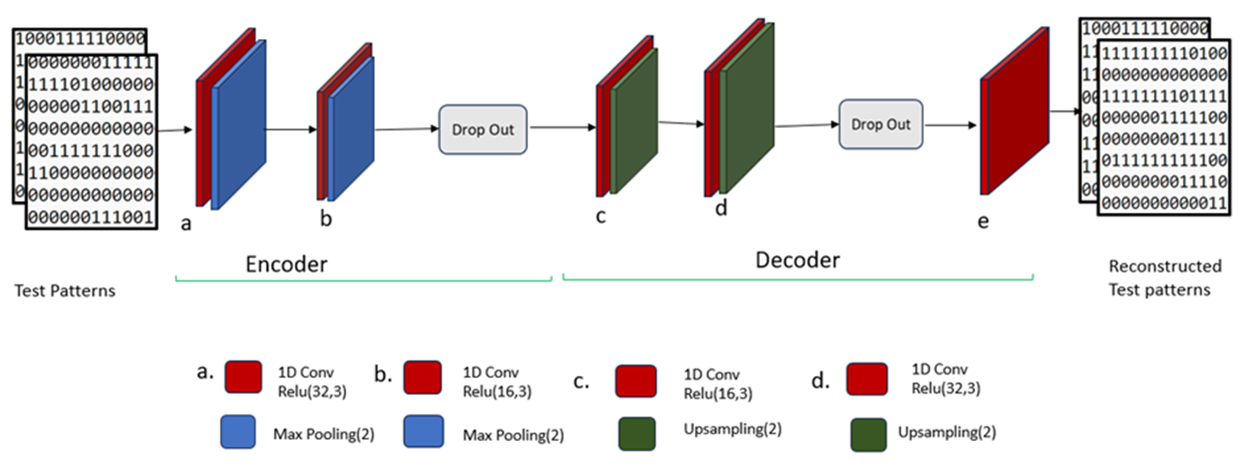
Proposed Convolutional Neural Network (CNN) Model
The CNN model takes test patterns made of 0s and 1s from the circuit. It uses filters to scan and find hidden error patterns in the data. Activation functions like ReLU help highlight important fault signals. Pooling layers reduce the size of data while keeping key features. Finally, the model classifies whether the circuit has a fault or not.
Fig. Convolutional Autoencoder model

Slide 21
Classification
In this project, we use the Random Forest algorithm for fault classification in VLSI circuits. It is a machine learning method that combines many decision trees to make accurate predictions. After the CNN and CAE models extract features from the test patterns, Random Forest helps decide if a pattern is faulty or fault-free. We chose Random Forest because it is fast, works well with complex data, and reduces overfitting. It gives more stable and reliable results compared to using a single model. This improves the overall fault detection accuracy. That’s why Random Forest is used as the final classifier in our system.

Slide 22
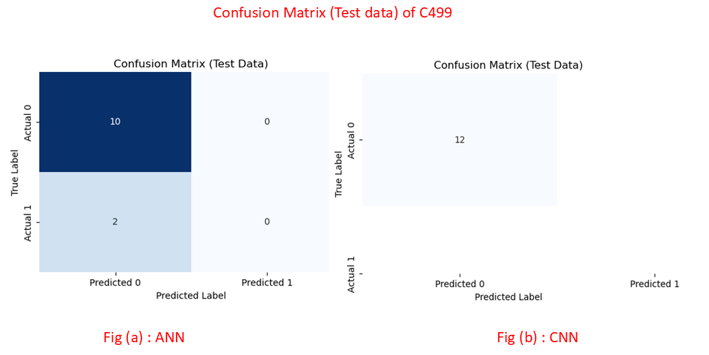
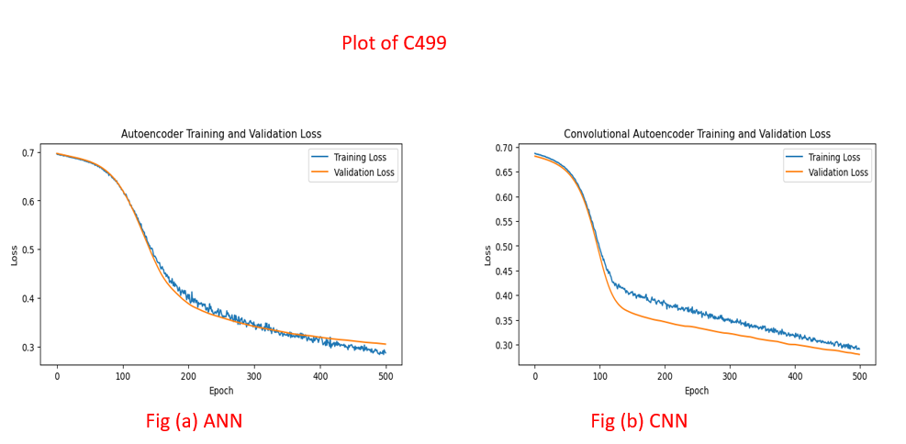
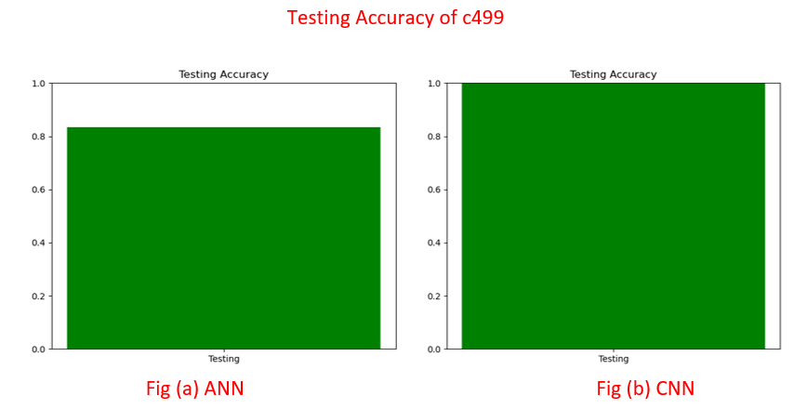
Results
C499 : 32-bit SEC circuit

Slide 23
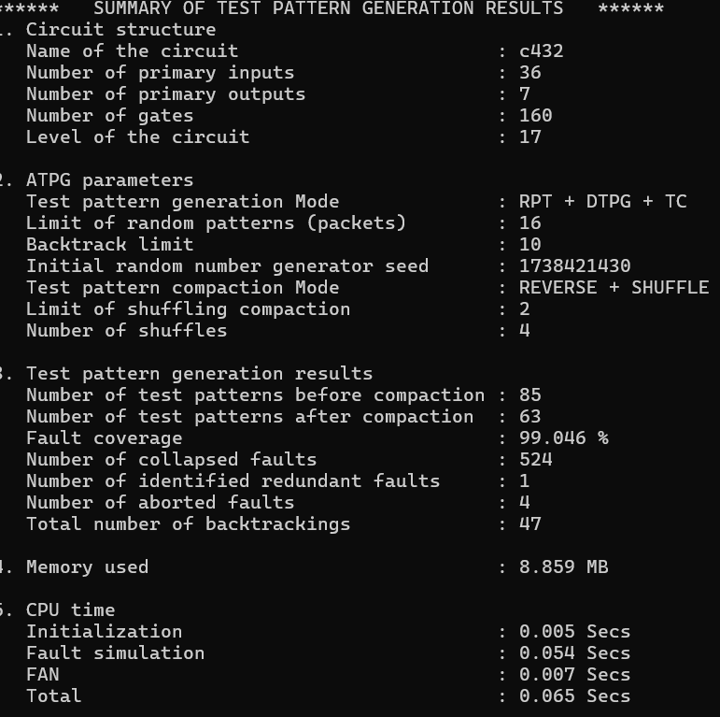
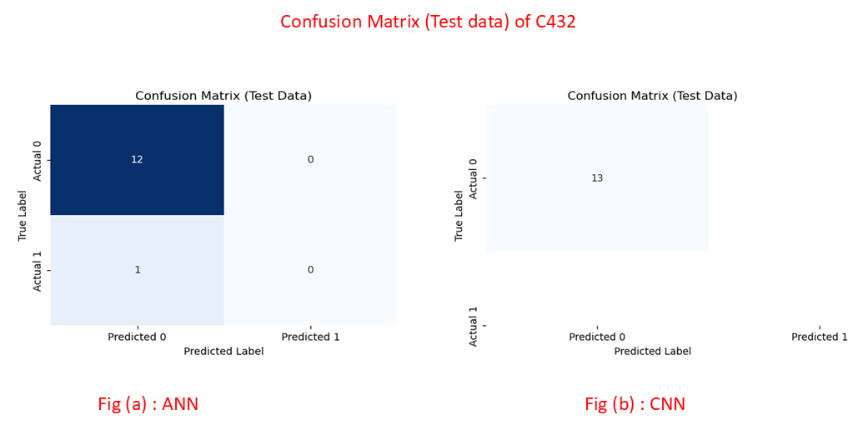
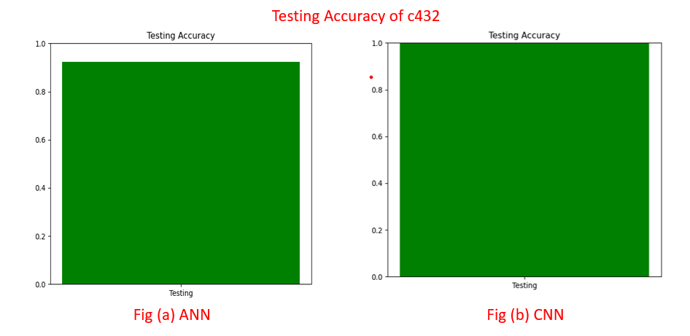
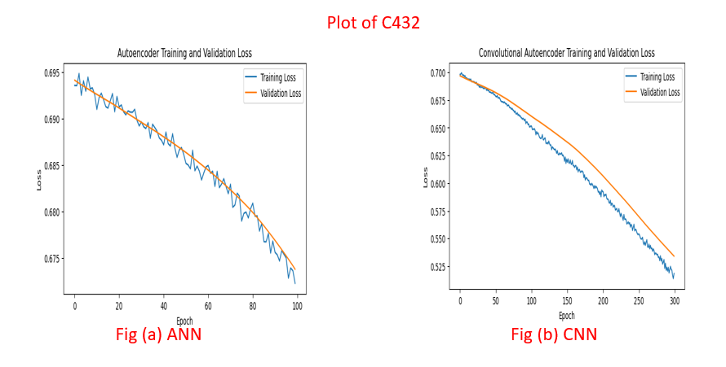
C432 : 27-channel interrupt controller

Slide 24
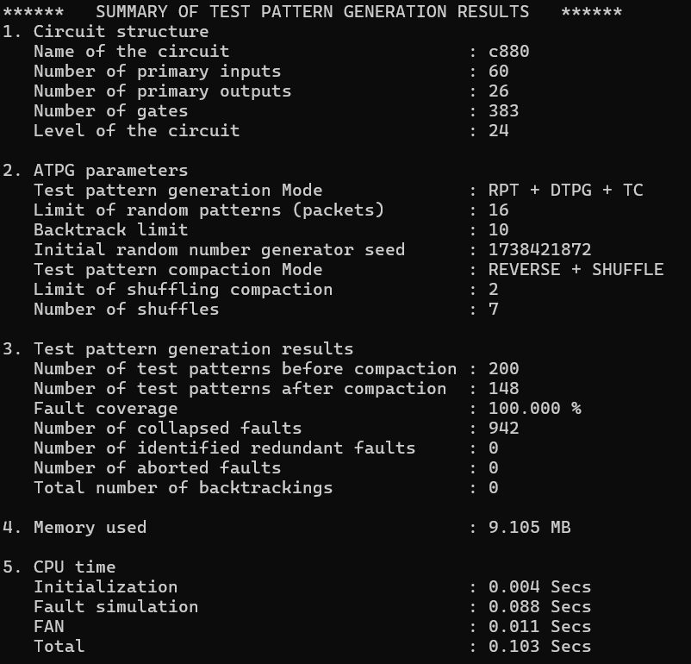
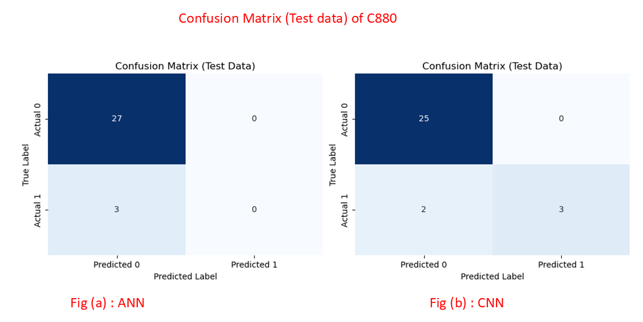
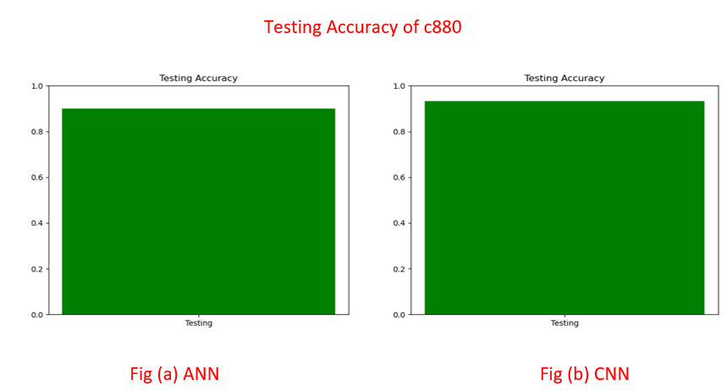
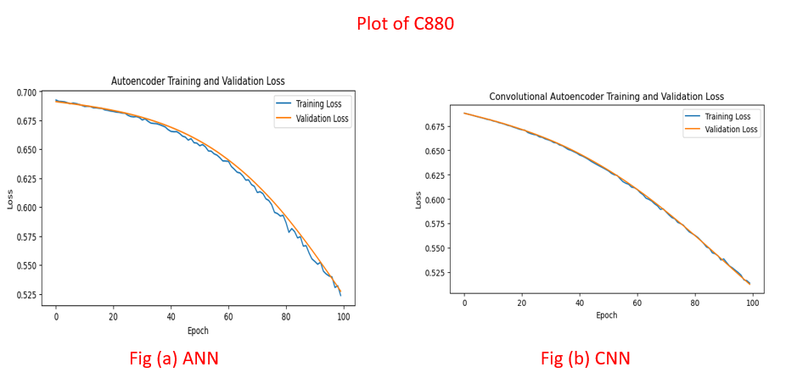
C880 : 8-bit ALU

Slide 25
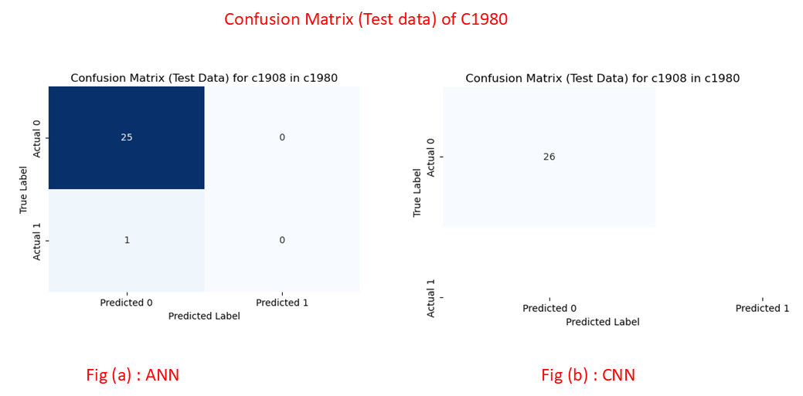
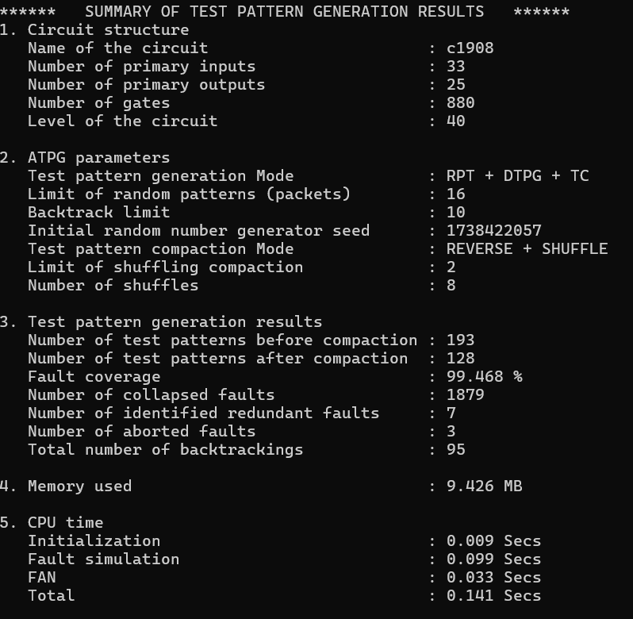
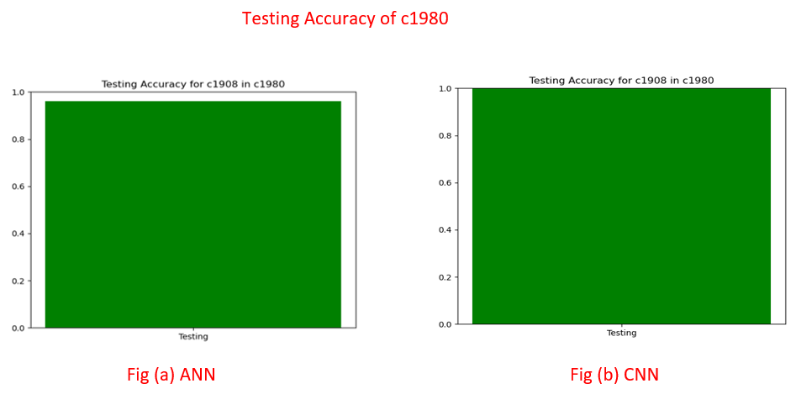
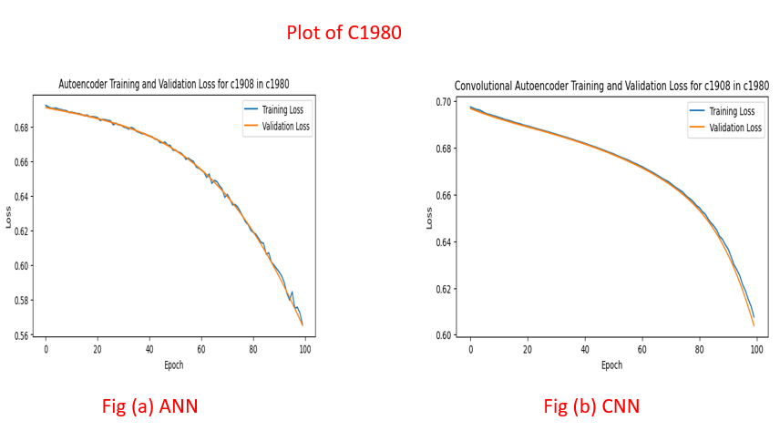
C1908 : 16-bit SEC/DED circuit

Slide 26
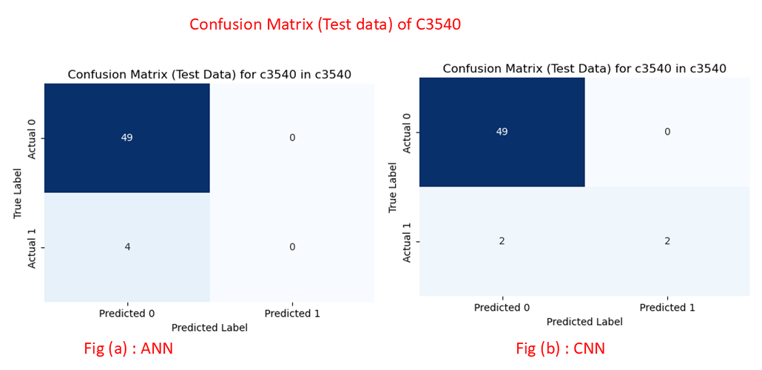
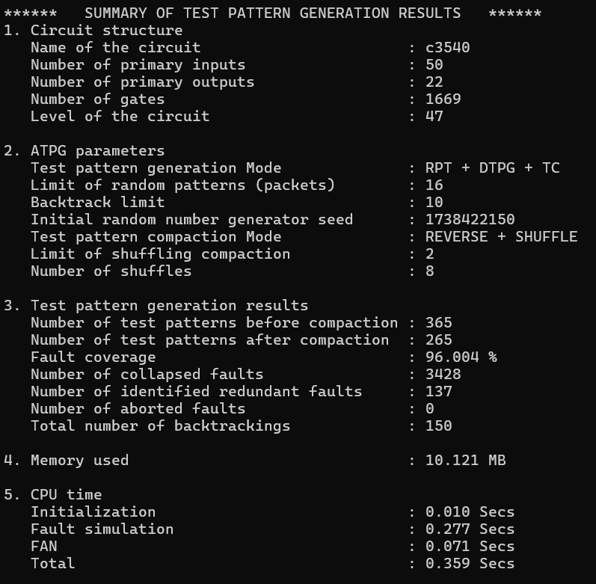
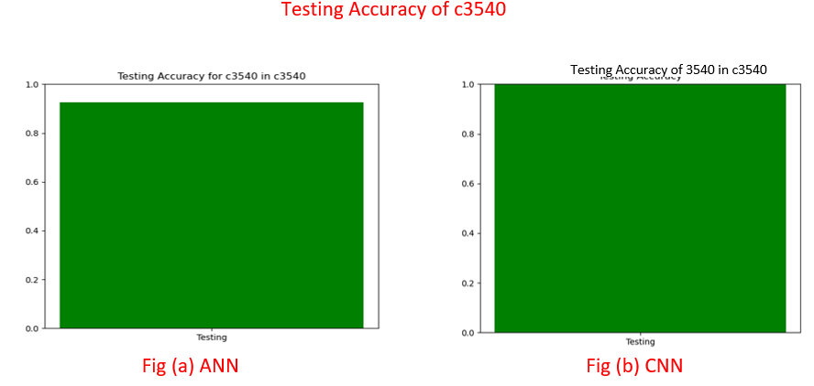
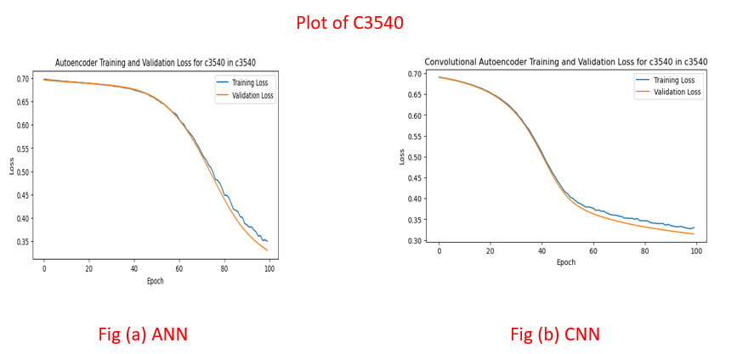
C3540 : 8-bit ALU

Slide 27
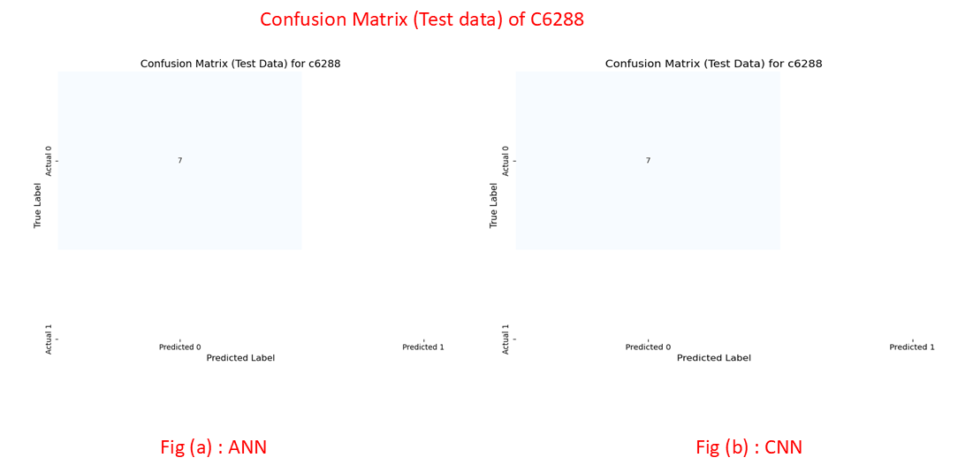
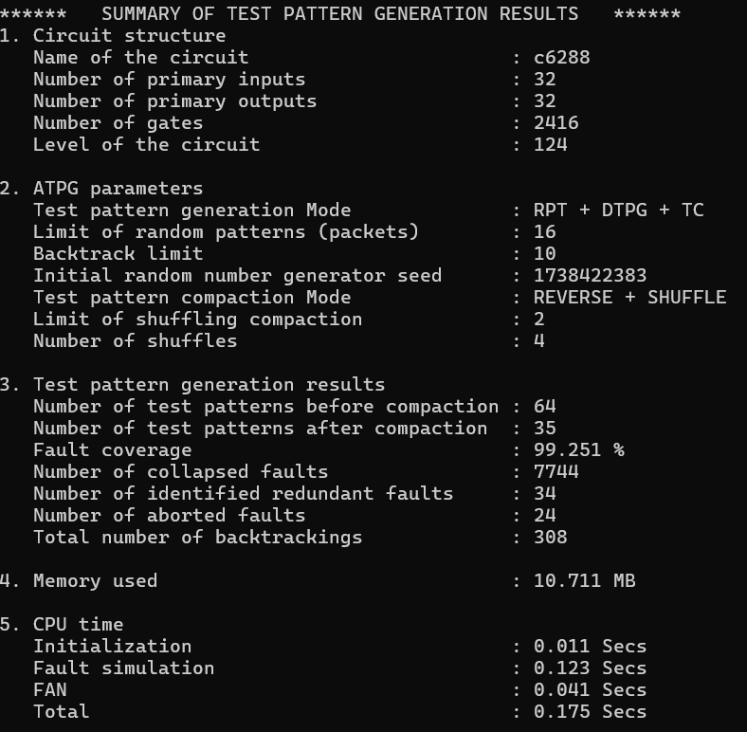
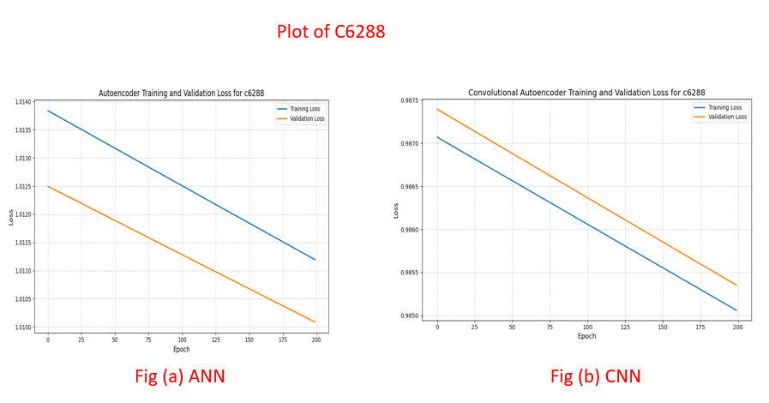
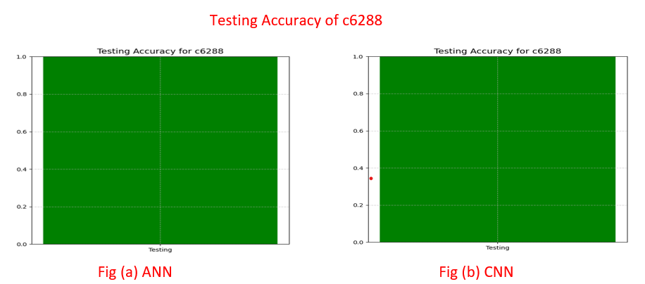
C6288 : 16x16 multiplier

Slide 28
Performance metrics for existing and Proposed model
A comparative analysis of fault detection performance between Artificial Neural Networks (ANNs) and Convolutional Neural Networks (CNNs) was conducted using ISCAS’85 benchmark circuits. The study evaluated both models based on training parameters, testing parameters, precision, recall, F1-score, support, and accuracy. The results indicate that CNNs consistently outperform ANNs in fault classification across various circuits. While ANNs achieved accuracy levels ranging from 83% to 100%, CNNs demonstrated superior performance, achieving 100% accuracy in multiple cases, including circuits C432, C499, C1980, and C6288. In circuits like C880 and C3540, CNNs maintained higher accuracy compared to ANNs, with 93% and 96% accuracy, respectively.
CNNs also exhibited higher precision and F1-scores, particularly in detecting faulty patterns, ensuring better classification reliability. The recall values remained at 1.00 for both models, indicating that they effectively identified fault-free patterns. However, CNNs provided enhanced fault detection with fewer false negatives, reducing the risk of misclassification.

Slide 29
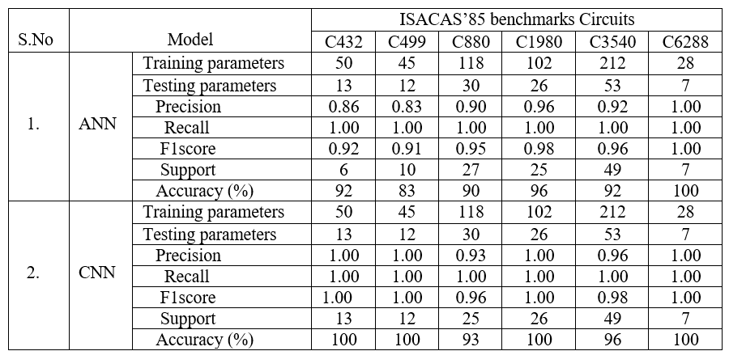
This improvement can be attributed to CNNs' advanced feature extraction and pattern recognition capabilities, which allow for better generalization and fault localization in complex circuits.

Slide 30
Conclusion
An automated fault detection and error debugging approach using a Convolutional Autoencoder (CAE) and Convolutional Neural Network (CNN) is presented. The method achieves high accuracy and outperforms Artificial Neural Networks (ANNs) in identifying faults. CNN models effectively reduce false negatives, improving fault detection and classification. Fault-free patterns are identified with high precision, while some faulty cases remain undetected. The approach enhances fault detection efficiency, minimizes misclassification, and improves debugging accuracy. Deep learning techniques provide better feature extraction and classification capabilities. The method adapts well to complex circuit structures and varying fault patterns. Further improvements can focus on refining fault detection for highly sequential patterns.

Slide 31
References
1. Jo S, Matsumoto T, Fujita M (2014) SAT-based automatic rectification and debugging of combinational circuits with LUT insertions. IPSJ Transactions on System LSI Design Methodology 7:46–55
2. Rashinkar P, Paterson P, Singh L (2007) Singh, System-on-a chip verification: methodology and techniques: Springer Science & Business Media
3. Gaber L, Hussein AI, Moness M (2019) Improved automatic correction for digital VLSI circuits. In 2019 Proceeding 31st inter national conference on microelectronics (ICM), 2019, pp 18–22
4. Gaber L, Hussein AI, Moness M (2020) Incremental Automatic Correction for Digital VLSI Circuits. Presented at the Proceceeding 11th International Conference on VLSI (VLSI 2020)

Slide 32
Future scope
In this project, the future scope revolves around enhancing fault detection in VLSI circuits by leveraging machine learning techniques, especially convolutional autoencoders (CAE) and convolutional neural networks (CNN). The system could be further improved by adding time-related factors, energy consumption details, or new types of test patterns, which would aid in detecting subtle faults. Expanding the system to handle even more complex, sequential circuit designs will make it adaptable to a wider variety of applications in the future. The implementation of this fault detection technique could potentially reduce manufacturing time and costs while improving the reliability of VLSI circuits in critical devices. Additionally, continuous learning from past mistakes could help the model evolve and become even more accurate in fault detection .

Slide 33
Thank You

